Slide 1
Tax in Denmark

Slide 2

Tax in Denmark - Introduction
Who pay taxes?
Everybody who lives in Denmark and who has an income – also if you
have your own business
are unemployed and receive benefits from your unemployment fund (daily benefits) or from the state (social assistance benefits)
are a student and receive state education grants
are retired and receive state pension
work abroad or have income from abroad while living in Denmark
Notes:
2
Introduction
In Denmark we are 5.6 million inhapitans – about one quater of what lives in Mexico
Everybody in Denmark – with an income– pay tax.
Whether you have a job, you study or are unemployed and receive benefits from the state or the municipality you have to pay taxes.
The Danish tax system is a complicated matter of rules and laws. The young citizens do not need to be familiar with everything, but it is important that they know what to do in relation to their own tax.

Slide 3
Tax in Denmark - Introduction
Welfare for all:
Cornerstones of the Danish Society
All must contribute
Public services throughout our lives
Denmark is a democracy and a welfare state:
Danish citizens have the right to vote
The tax is used for public services providet by the state, the regions and the municipalities.
What are the tax funds used for?:
Hospitals, medical care, education, and so on
Notes:
3
Welfare for all
TAX is one of the cornerstones of the Danish society. In Denmark we have decided that all of us have to contribute towards the public purse. In return, we are entitled to a number of public services throughout our live.
Denmark is a democracy. In practice, Danish citizens have a voice in how the Danish society, including the welfare and the tax system, is put together by voting for a politician or a party in the elections.
Even if we find that we pay too much tax, the majority of us also believe that both individuals and society in general benefits from the tax system.
Denmark is a welfare state, meaning that the tax we pay in the form of income tax, VAT, duties and customs duties are used for public services provided by the state, the regions and the municipalities.
The tax funds are used to cover expenses for hospitals, medical care, education, the police force, the army, public transport and maintenance of infrastructure, etc. Additionally, the tax funds finance the state education grants (SU), social assistance benefits and social pensions.
However, you need to pay for certain things yourself, such as medication, textbooks for higher education or dental care.
The Danish welfare model aims to provide security, affluence and equality of opportunity for all.
We are all users of the public system, one way or the other. And in principle, we all have to pay towards it. Still, we are taxed individually. The Danish tax system is progressive, meaning that the higher your income, the higher an amount of tax you have to pay. The tax can be up to 62% of the last owned money.
This principle is reflected in the proverb: “Those with the broadest shoulders should bear the heaviest burden”.

Slide 4
What do we do for our young citizens?
We teach the young citizens in following main topics:
Why do you pay tax
The Danish welfare state
What is the tax money used for
Moonlighting/undeclared work
How to avoid tax underpayment
SU and after-school job
Explanation of Tax terms
Reconcile information to their needs
It has to be present for them
Notes:
4
In Denmark young citizens are an important target group
We teach the young people in following main topics:
• Why do you pay tax
• The Danish welfare state
• What is the tax money used for
• Moonlighting/undeclared work
• How to avoid tax underpayment
• SU (State Education Grants) and after-school job
• Explanation of Tax terms – the young citizens don’t understand our language and our terminology.
The timing of the information is very important, so the Young people get to know about it at a point in their lives where it is present for them.
It may depend on age, whether they have after shool-job, they get su etc..
in Denmark, young people aged over 18 years, studying at gynnasiale and higher education and certain vocational education, get a benefit. This benefit is called SU. And they get up to about 1000 us dollars pro month.

Slide 5
Why do we teach the young citizens?
We teach them because:
We want them to be good citizens
We want to help them to get a good start in terms of finances
We want them to know their rights and their obligations
Notes:
5
we try to help young people to get a good start, to make sure that they pay the right tax, no more or no less!
We want them to be good citizens
We want to help them to get a good start in terms of finances
We want them to know their rights and their obligations

Slide 6
Places where we teach young citizens
We try to make contact with the young people on different channels
Via websites
Via social media
Via ambassadors
Via personal contact
We meet them face to face at their schools
In the classroom
At public meetings
At morning assemblies
At café meetings
Notes:
6
We try to make contact with the young people on different channels
Via websites
Via social media
Via ambassadors
Via personal contact
We attend schools and teach the young citizens - sometimes it's in classrooms, sometimes large meetings and other times it is a little presentation at morning assembly and subsequent cafe meetings, where young people can come and learn about their taxes.
Last year we have personal contact with about 16.ooo young citizens.

Slide 7
How we teach them
Various tools:
www.skat.dk/unge
The purpose of the site is to make young people digitally self-reliant in TastSelv.
The site is built on the situations in which young people should do something - when they have an after-school job, receive SU etc.
It contains short and concise guide features.
www.skat.dk/skole
Provides educational materials
Tasks dilemma
Exercises
Presentations
Notes:
7
In our education of the young people we use
The website skat.dk/unge The site is aimed at 15-25 year-olds and is designed in close cooperation with young citizens.
The purpose of this site is to make young citizens digitally self-reliant in e-services.
The site has been prepared on the basis of previous projects and studies. These insights showed how young people experiencing barriers to manage their own tax affairs. The site is built on the situations in which young people should do something - when they get a after-school job, recieve SU etc.. – The site contains short and concise guide features.
The website skat.dk/skole The purpose of the site is to provide educational material on tax that teachers can use in their teaching. The site contains various tasks dilemma and exercises, and a power point show about tax and society. The desire is to get the Ministry of Education to highlight the concept of tax in order that it becomes a mandatory part of the curriculum in certain subjects and grade levels in elementary and secondary schools / business schools. It is our intention that by the end of Q1 2015, we have a teaching material / concept ready, so that teachers can undertake the education of the students.
Skat.dk study
Finally, we have www.skat.dk/study. Here you, in English, can read about what you should do regarding your taxes if you are studying in Denmark.
Right now we are devoloping new teaching materials

Slide 8
How we teach them (continued)
Teaching through the use of ambassadors
Su/counselors
Ministry of Education
Teacher associations
Guest teacher education/system
Materials about welfare state, risks of undeclared work, annual inventory and preliminary income.
Videos
Cases
Notes:
8
Teaching through the use of ambassadors.
To reach more young people with our message, we work with ambassadors
Su/counselors - SU / counselors are important ambassadors, they are in the schools and try to answer questions about tax and refers in particular to skat.dk/unge in their daily work with the students.
We are in contact with the counselors by mail – and provide information about important topics. Some times we send them posters they hang up at the schools.
The Ministry of Education and som teachers associations helps us to develop teaching materials so that teachers in primary schools can teach about taxes.
The desire is to get the Ministry of Education to highlight our concept in order that it becomes a mandatory part of the curriculum in certain subjects and grade levels in elementary and secondary schools / business schools
We also cooperate with the Ministery of Finance. We have one week where we try to make focus of young citizensand their økonomi.
Guest teacher education/system
SKAT has some materials, videos, cases ect. which our guest teachers can use for education of the students. The purpose of the course include to teach young citizens about the connection between their annual inventory and preliminary income, tell them about the risks of undeclared work and to make them aware of the tax's role in the welfare state. In order to make the teaching identical nationwide we have prepared scripts for the guest teacher education for each of the segments: Primary School 9th and 10th grade, secondary education and vocational education.

Slide 9
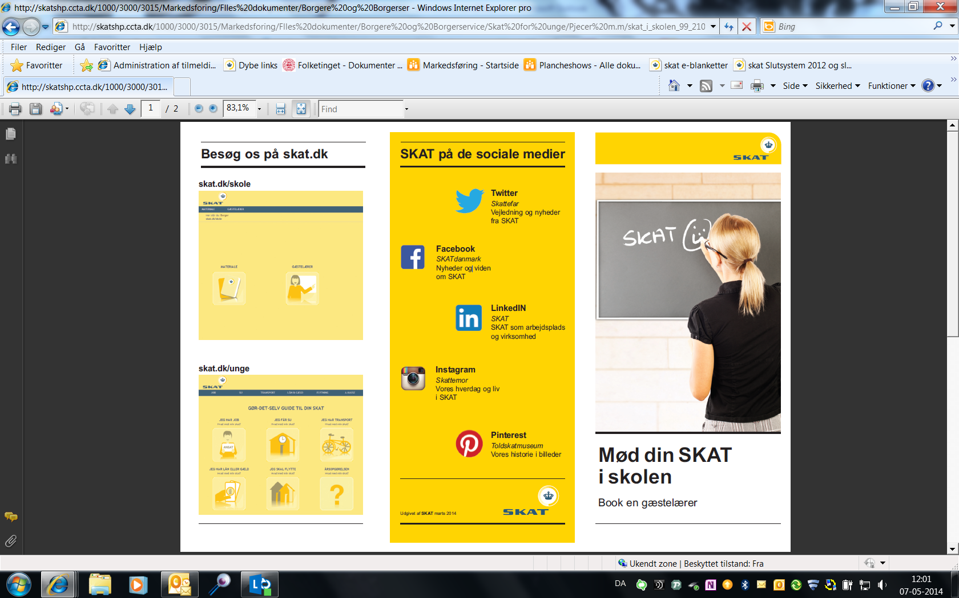
Dear Borja
I am responsible for tax education af young people in Denmark. We have spent years made ​​some steps towards young people. In the primary School, at business schools, colleges, at universities etc. Finally, we have participated in events where young people, who come to Denmark to study, can come and ask questions, so they do not end up with a tax underpayment. We go to schools and teach the young people- sometimes it's in classrooms, sometimes large meetings and other times it is a little presentation at morning assembly and subsequent cafe meetings where young people can come and ask questions of their taxes.
The main topics are as follows: • Why do you pay tax • The Danish welfare state • What is the tax money used for • Moonlighting/undeclared work • How to avoid tax underpayment • SU and after-school job • Explanation of Tax terms
We have a young site as a part of SKAT's website www.skat.dk/unge. Here young people in an easy way can find information of tax. The site is built around life situations, for example, I have a job, I get SU, I have transportation, etc.. We also have videos so young people can see how, for example, they make their first tax exemption card. We also have a school site www.skat.dk/skole, where we have various materials which teachers and students can use in their teaching. There are both arithmetic operations and basis for discussion. There is also a video that tells the story of a girl who guides around the tax universe. Currently we are developing new teaching materials. We have no Video Games yet. Finally, we have www.skat.dk/study. Here you, in English, can read about what you should do regarding your taxes if you are studying in Denmark. We are also on the social media and on you tube. Museum Customs and Excise Museum opened in 1912 as a tariff museum. In 2012, the Customs and Excise Museum was 100 years. Customs and Excise Museum Langeline is closed by December 2011 and now it lives on here at toldskatmuseum.dk.
We are now exclusively a digital museum as befits a modern digitally transferring authority.. The Customs and Excise Museum disseminated an exciting part of Denmark's history in stories, photos and articles. From the Middle Ages to today, the royal and state power ensured that paid duty and taxes to the general fund. We do not just tell the story of one of the oldest bureaus. We tell the story of the development and financing of the Danish welfare state.
Tell me if there's something you should have elaborated.
Notes:
Tax is now on the social media. And you tube. Each social media can keep up with what's happening in SKAT.
The social media Provides service: Helping you understand the rules, laws and concepts We use Facebook and Twitter to send messages out that are relevant and useful to citizens and businesses. We/the sender always write a name so you/the recipient knows who he/she is “talking” with.
LinkedIN - SKAT as a workplace
Instagram – the daily life at SKAT
Pinterest – The museum of SKAT, our history in pictures
On twitter we got a lot af credit for speacking in a language that Citizens understand.

Slide 10
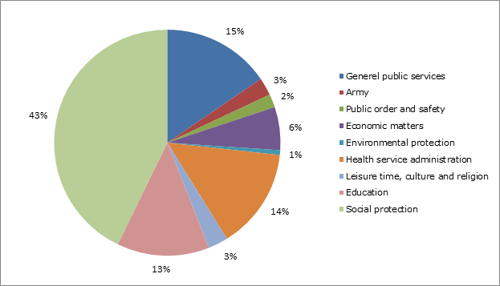
How is the tax revenue distributed?
The above illustration shows the overall 2012 distribution of tax revenue.
Notes:
When we teach the young people we engage them in a dialogue about The Danish welfare state.
We're trying to put it in perspective for something they can relate to….
if you have not contributed - should you then have the opportunity to go to the hospital? If the class is going on a school camp and there are two, who have not paid, will they be allowed to participate.
We tell them how much it costs the society that they go to school and maybe we convert it to how many Ipads or something they can relate to.
Sometimes we use a poster with pictures of roads, hospitals etc. and then the students put up prices.
In other words – we try to involve the students in the classroom so it does non become one way information.

Slide 11

Thank you
kirsten.b.hansen@skat.dk

